Slide 1




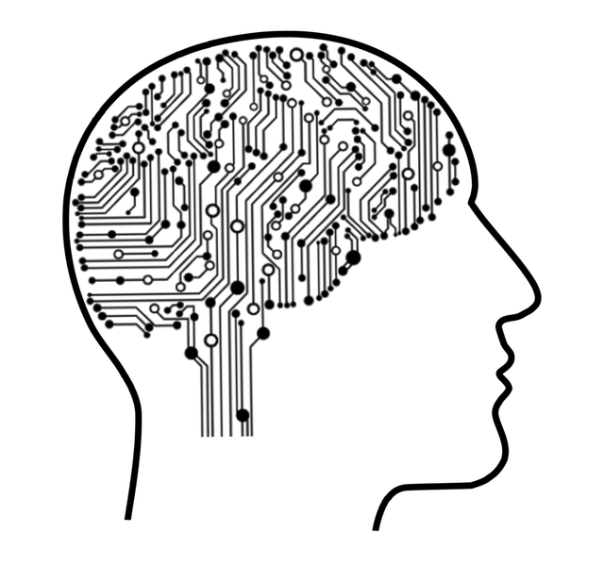
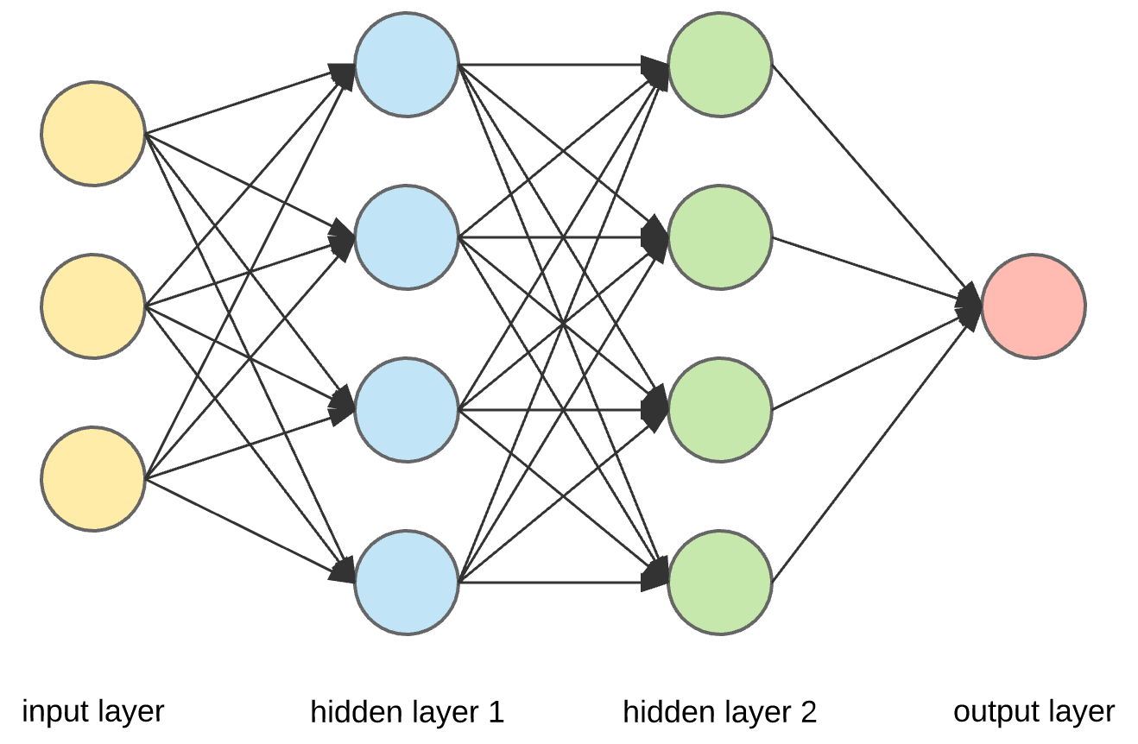
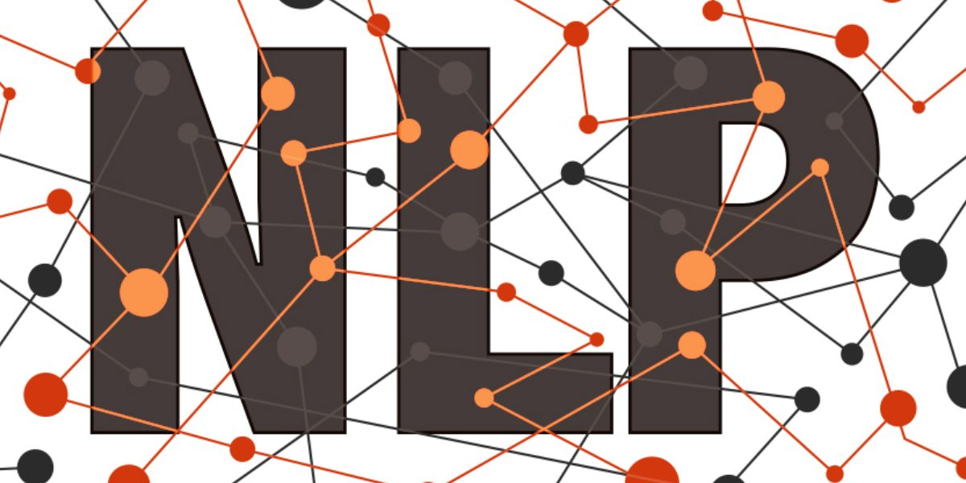
Python & TensorFlow
The Roadmap to Deep Machine Learning

Slide 2
TensorFlow
TensorFlow is a software library or a open-source framework developed by Google for the purposes of conducting machine learning and deep neural network research.
TensorFlow is a machine learning Library written in python, C++ ,CUDA.
It is used for Machine learning Application such as Neural Network.
The name "TensorFlow" comes from the way it handles data, using multidimensional arrays called "tensors" that flow through computational graphs.

Slide 3
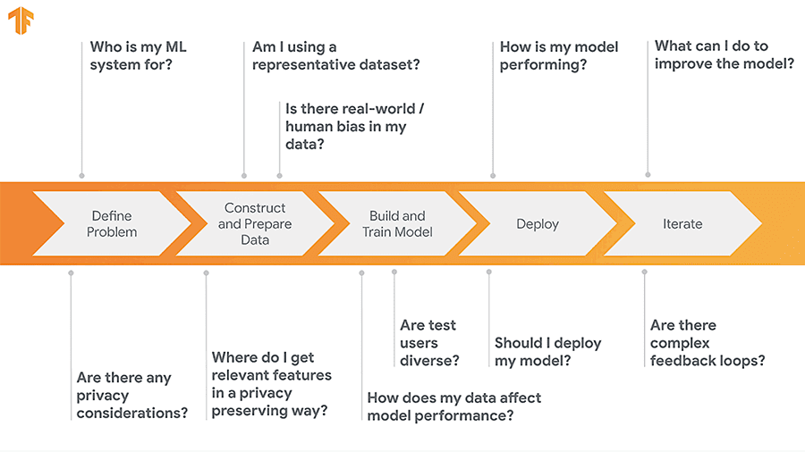
Keywords
Versions
ML
ANN
SGD
DataFlow Graphs
Libraries
Functionalities
Model Building

Slide 4
Versions of TensorFlow
1.2.0 2.0.0
CPU GPU
(Based) (Based)
12GB Graphics
16GB RAM
!pip install TensorFlow==1.2.0
We can implement and perform building models in Jupyter Notebook or Google Collab
TensorFlow is in-demand tool for
ML Engineers
AI Engineers
It is used to build Machine learning and especially Neural Network models

Slide 5
How does TensorFlow Work?
It provides a feature helps to create structures for ML model
This Structures are dataflow Graphs
They consist of nodes which are in well defined order which consist of methods of computation and denote the functionalities
This dataflow graphs also shows us how data including its functioning moves through graph.
This data that we need to feed consist of multidimensional array called Tensors.
TensorFlow is used by researchers, data scientists, and developers to build and deploy machine learning applications in various domains.

Slide 6
Procedure:-
Data Preprocessing :-
Data preprocessing is the process of cleaning, organizing, and transforming raw data into a structured and usable format for analysis or machine learning. It involves tasks such as data cleaning to remove errors and inconsistencies, data transformation to convert data into a suitable representation, and data reduction to reduce the volume while retaining important information.
1
Model Building
Model building refers to the process of creating and designing a mathematical or computational representation of a real-world system, phenomenon, or problem. In the context of data science and machine learning, it involves selecting an appropriate algorithm or approach, training the model on data, and tuning its parameters to make predictions, classifications, or decisions based on new input data.
2
3
Model Training and Evaluating:-
Model training involves using a dataset to teach a machine learning model to make predictions or classifications. Model evaluation assesses its performance by testing it on a separate dataset, measuring accuracy, and identifying any potential issues like overfitting or underfitting.

Slide 7

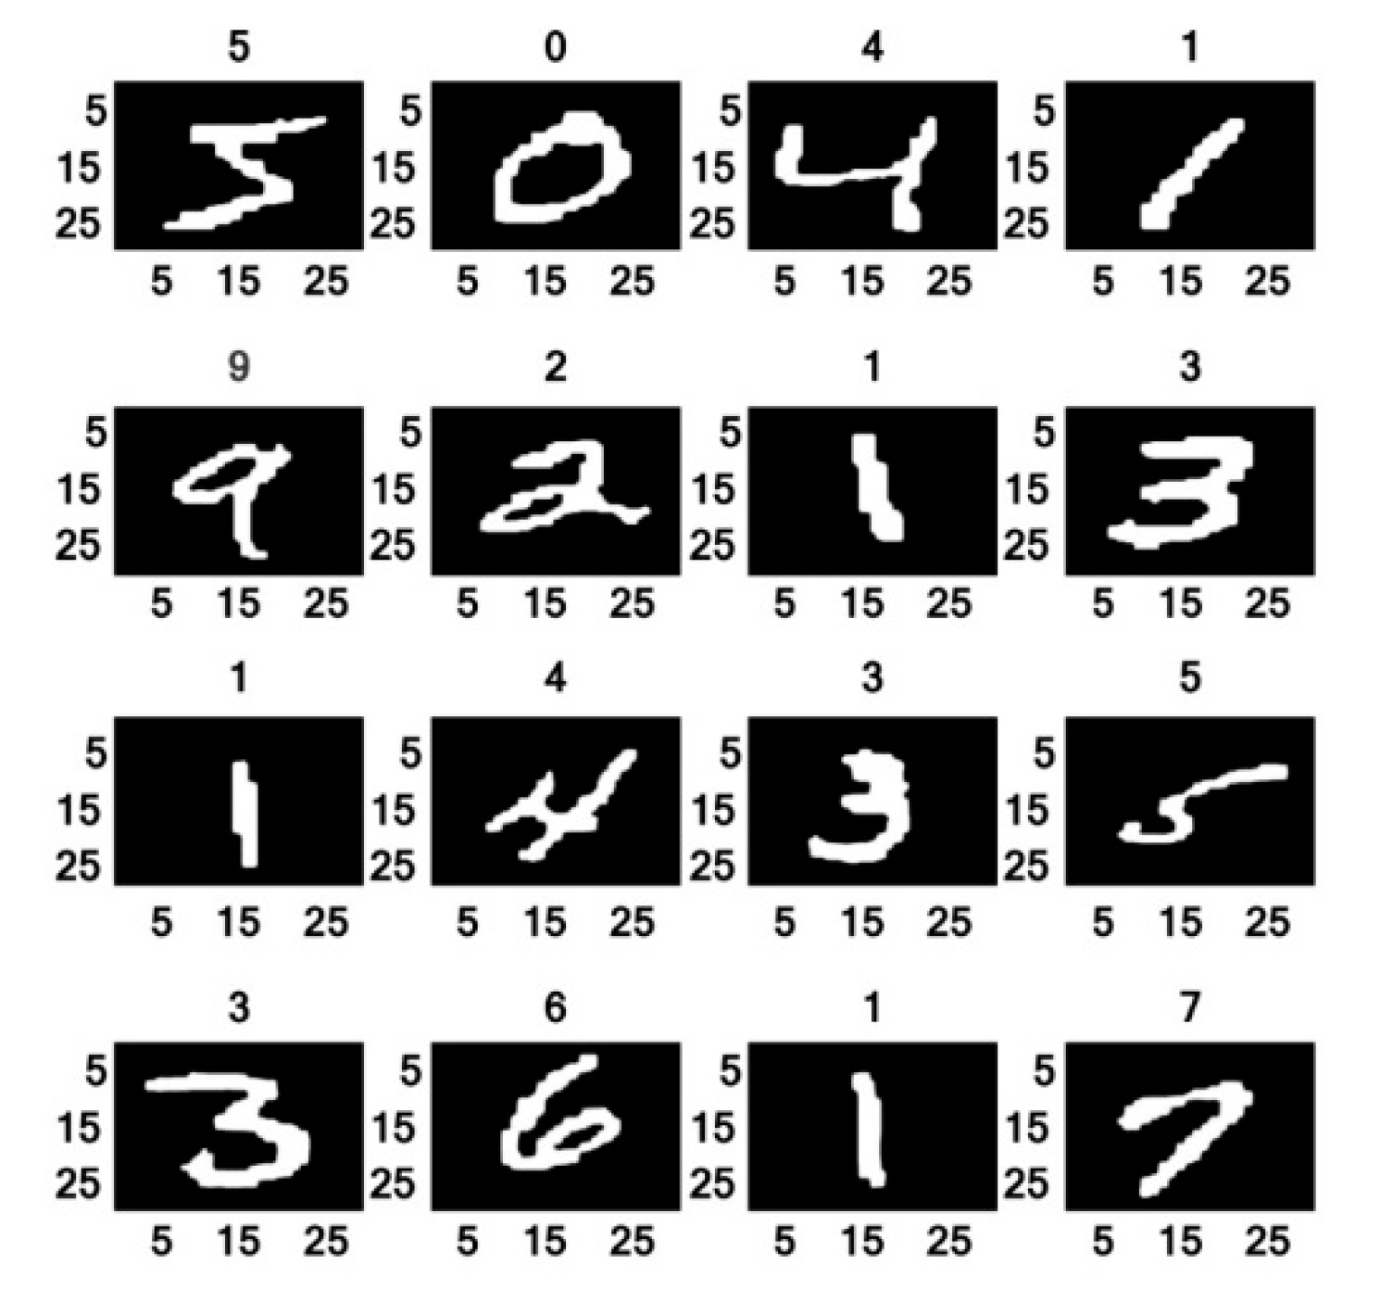




Neural Network and Image recognition
Natural Language Procession
Digit Classification
Train and Execute

Slide 8
TensorFlow & Libraries
Keras: An easy-to-use high-level neural networks API that runs on top of TensorFlow. Keras simplifies the process of building and training neural networks.
TensorFlow Hub: A repository of pre-trained machine learning models that can be easily reused in your own projects. It's a great resource for transfer learning.
TensorFlow Lite: A framework for deploying machine learning models on mobile and embedded devices, enabling on-device inference for applications like mobile apps and IoT devices.
TensorFlow.js: A JavaScript library that allows you to run TensorFlow models directly in web browsers, making it useful for creating browser-based machine learning applications.
TensorBoard: A tool for visualizing and analyzing TensorFlow models. It helps with monitoring training progress, debugging models, and understanding model performance.
TensorFlow Serving: A library for deploying machine learning models as production services, making it easier to serve models in real-world applications.
TFX (TensorFlow Extended): An end-to-end platform for deploying production machine learning pipelines. It includes components for data validation, preprocessing, training, and serving.
TFLite (TensorFlow Lite): A set of tools and libraries for optimizing and converting models for inference on mobile and embedded devices.
TF-Agents: A library for reinforcement learning, providing components for building and training reinforcement learning models.

Slide 9
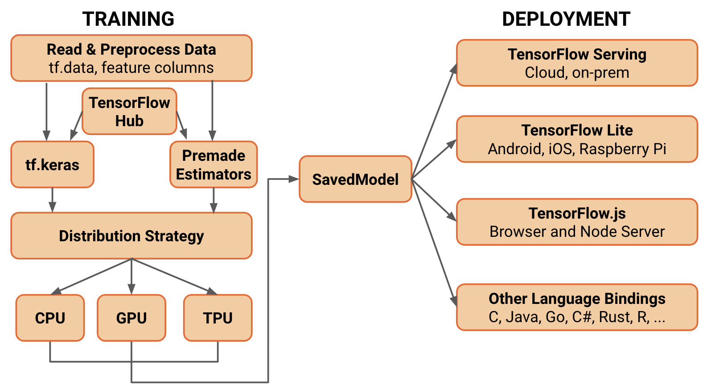
TensorFlow Model
https://github.com/Atharva-More/TensorFlow-churn-model

Slide 10
Algorithm and ANN
Stochastic Gradient Descent (SGD) is an optimization algorithm used in machine learning and deep learning to train models, including neural networks. It is a variant of the gradient descent algorithm that is particularly well-suited for large datasets and high-dimensional parameter spaces. Here's an explanation of how SGD works.
Initialization
Iteration
Loss Calculation
Gradient Calculation
Parameter Update
Repeat
ReLU, which stands for Rectified Linear Unit, is an activation function commonly used in artificial neural networks, especially in deep learning models. It is a simple mathematical function that introduces non-linearity
f(x) = max(0, x)
In this equation, "x" represents the input to the activation function, and "f(x)" is the output. The ReLU function computes the output as follows:
If the input "x" is greater than or equal to zero, the output is "x" itself (i.e., no change).
If the input "x" is negative, the output is zero.

Slide 11
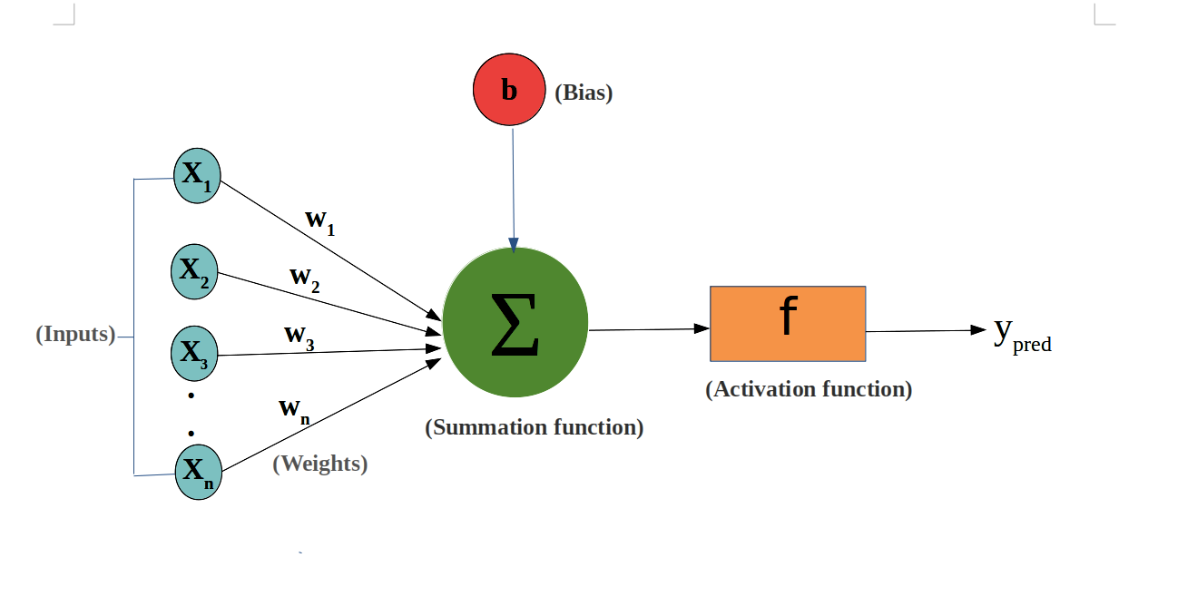
Summation (Weighted Sum):
The summation step involves calculating a weighted sum of the inputs to a neuron. Each input is multiplied by a weight, and the products are then summed together. Mathematically.

Slide 12
Literature Survey
Sr. No. | Reference Name | Seed Idea/ Work description | Problems found | Future sco.
1 | CNN model Design of Plant Recognition Based on TensorFlow Framework | This research study uses Convolutional Neural Networks (CNN) with the TensorFlow framework in Python to identify plant species based on leaf images. | Variability in Leaf Data: Handling variations in leaf data, such as different species, lighting conditions, and leaf shapes. | Field Applications: Implementing the model in real-world field applications, such as mobile apps or handheld devices
2 | Study on the application of TensorFlow compression Techniques to Human Activity Recognition | This research paper delves into the practical application of TensorFlow compression techniques in the domain of Human Activity Recognition (HAR) | Loss of Information: Implementing compression techniques while avoiding the loss of critical information | Continuous Learning: Developing adaptive models that can continuously learn and update their recognition capabilities
3 | TensorFlow: A System for Large scale Machine learning | TensorFlow is a powerful machine learning system designed for large-scale and heterogeneous computing environments | Edge and IoT Devices: Adapting TensorFlow for deployment on edge and Internet of Things (IoT) devices, where computational resources are constrained. | Human-Machine Collaboration: Investigating ways to facilitate humanmachine collaboration, where TensorFlow helps humans make more informed

Slide 13
Conclusion
In conclusion, TensorFlow has emerged as a cornerstone of modern industry and development, revolutionizing the way we approach complex tasks in areas such as artificial intelligence and machine learning. Its versatility and scalability empower organizations to harness the potential of data, enabling innovative solutions, automation, and insights that were previously unimaginable. As we navigate the ever-evolving landscape of technology and data, TensorFlow continues to be a driving force, propelling us into a future where the possibilities are limited only by our imagination.

Slide 14


Title of the Seminar: Python & TensorFlow: The Roadmap to Deep Machine Learning Expertise
Domain: Machine Learning and Deep-Learning
References: (min 10)
List of References
Qifei Dong, Xiaoyi Zhang,” Improving the Accuracy of Progress Indication for constructing Deep Learning Models”, IEEE May 2022’
Karthik Pattabiraman, Senior Member, IEEE, and Nathan Debardeleben“Fault Injection for TensorFlow Applications”, July/August 2023
Arjya Das, Mohammad Ansari, Rohini Basak ,IEEE,” Covid-19 Face Mask Detection Using Tensorﬂow, Keras and OpenCV” , March 2021
Amin Biglari and Wei Tang ,Member IEEE,” A Vision-Based Cattle Recognition System Using TensorFlow for Livestock Water Intake Monitoring”, November 2022
M Manoj Krishna, M Neelima, IJET,” Image Classiﬁcation using Deep Learning “, August 2019
Zixian Zeng , Qingge Gong 2019IEE 3rd Information Technology ,“CNN model Design of gesture Recognition Based on TensorFlow Framework”, March 2019
Chiara Contoli and Emanuele Lattanzi ,University of Urbino, IEEE,” A Study on the application of Tensorﬂow compression Techinques to Human Activity Recognition ” , May 2023

Slide 15
Martin Abadi and more “Tensorﬂlow: A System for Large scale Machine learning”, Google Brain
“Examining the Runtime of NLTK and TensorFlow Algorithms for Chatbot Based on intents.json” , Ravi Krishna à TechRxiv (By IEEE)
Pradumn Kumar, Upasana Dugal ,“Tensorﬂow based image classiﬁcation using advance CNN”, March 2020
Thankyou!

